Slide 1
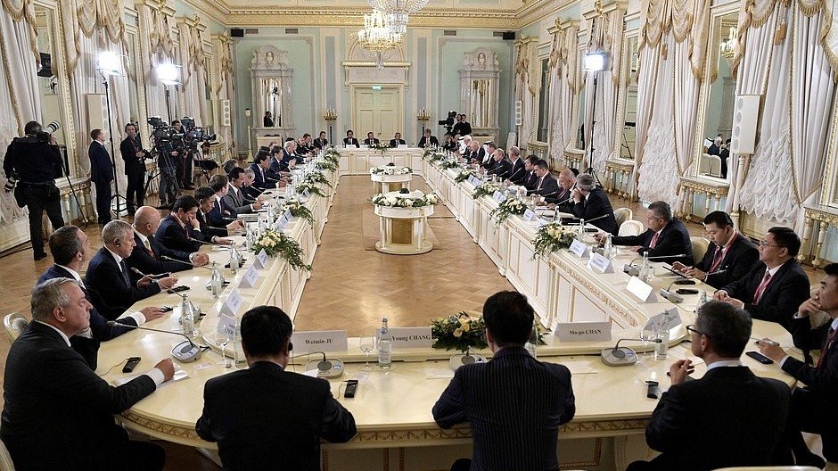
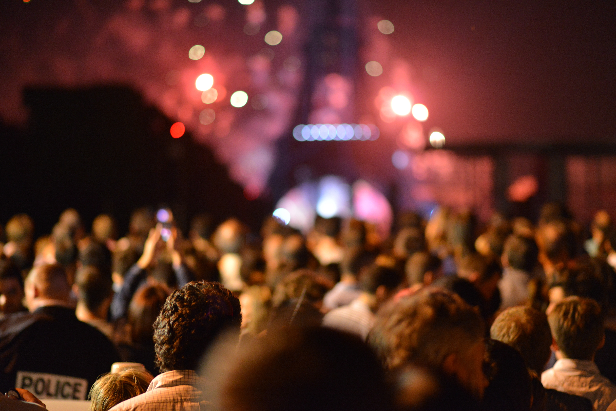
EVENT MANAGEMENT SYSTEM

Slide 2

INSIDE THE PRESENTATION
Introduction
Conclusion
Project Overview
Class Diagram
Project Demo
Technologies Used
Benefits of the System
EER Diagram
Schema Diagram

Slide 3
INTRODUCTION
This cutting-edge system is designed to revolutionize the way we plan and manage events, from small gatherings to large-scale conferences.
With the Event Management System, you'll have all the tools you need to create unforgettable events that leave a lasting impression on your guests. Whether you're planning a corporate event or a wedding, this system has got you covered. But don't just take my word for it – let's dive into the details and see what makes this system so special.

Slide 4
PROJECT OVERVIEW
SCOPE OF THE PROJECT
Developing a user friendly and intuitive interface that can be accessed from any device with an Internet connection.
TARGET AUDIENCE
Event organizers, planners, customers, and promoters who need a reliable and efficient tool for event management.

Slide 5
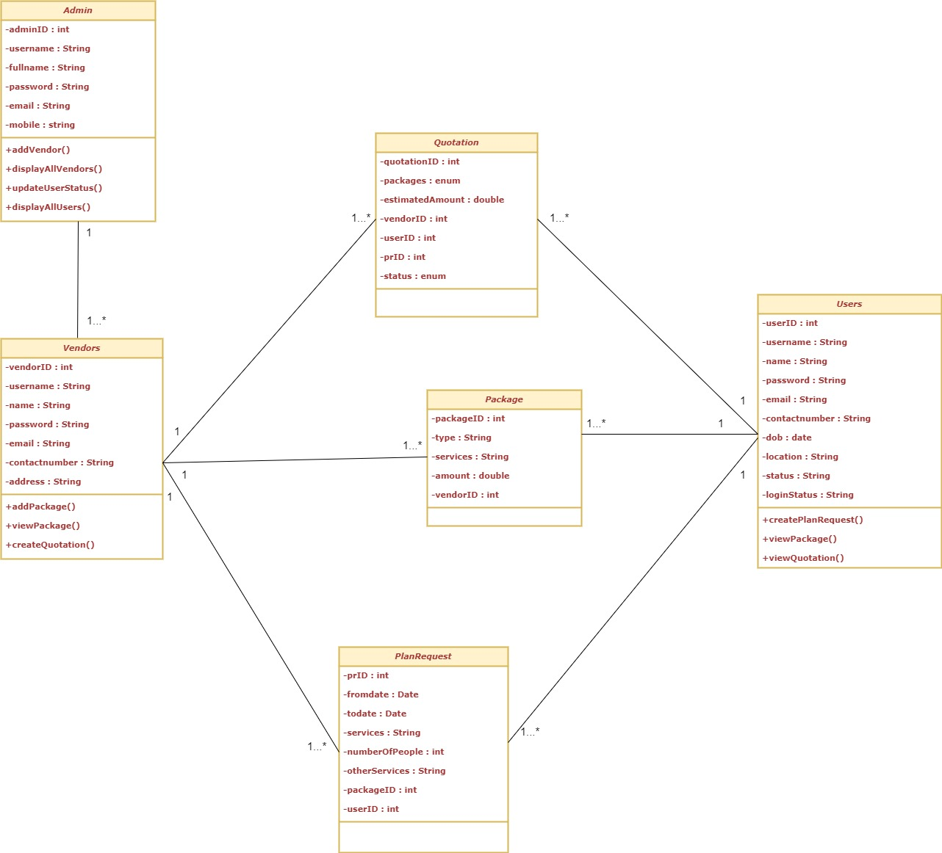
Class Diagram

Slide 6
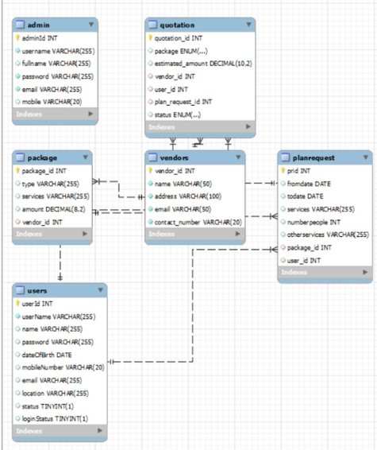
EER DIAGRAM

Slide 7
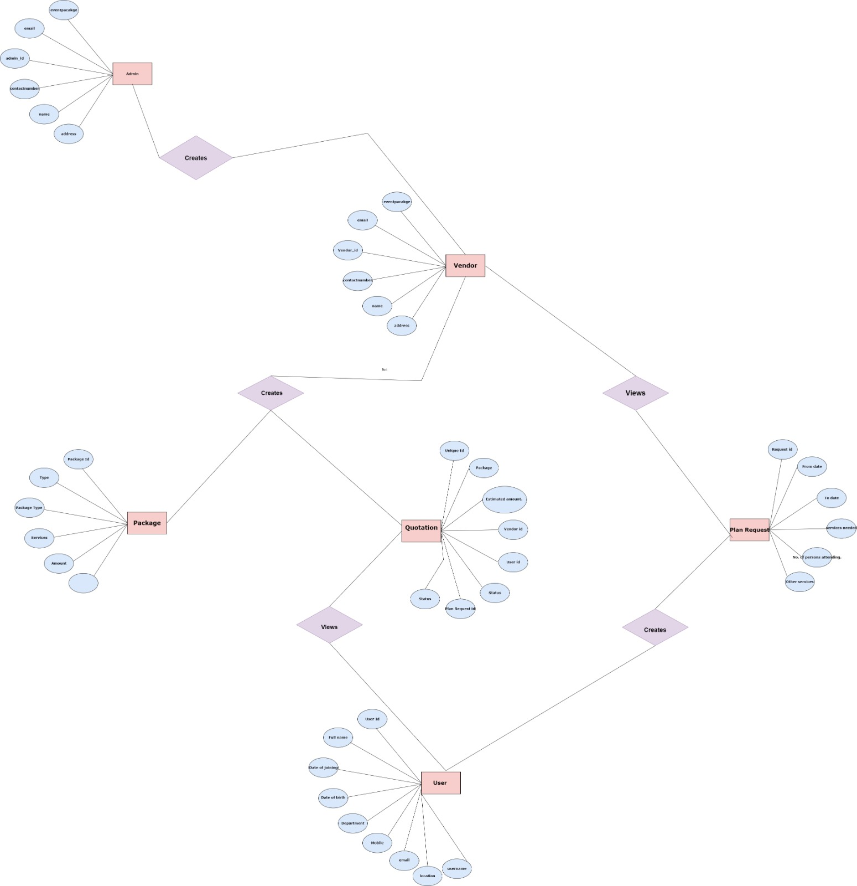
SCHEMA Diagram

Slide 8
TECHNOLOGIES USED
The Event Management System was developed using a variety of technologies, including Java, MySQL, HTML, CSS, and JS.
Java: Backend Development
MySQL: Database Management System
HTML and CSS: Front-end Development
JS: Dynamic functionality and interactivity on the website.

Slide 9
PROJECT DEMO
The project consists of four main aspects:
Home Page
Admin
Users
Vendors
Each page has different sub-functionalities.

Slide 10
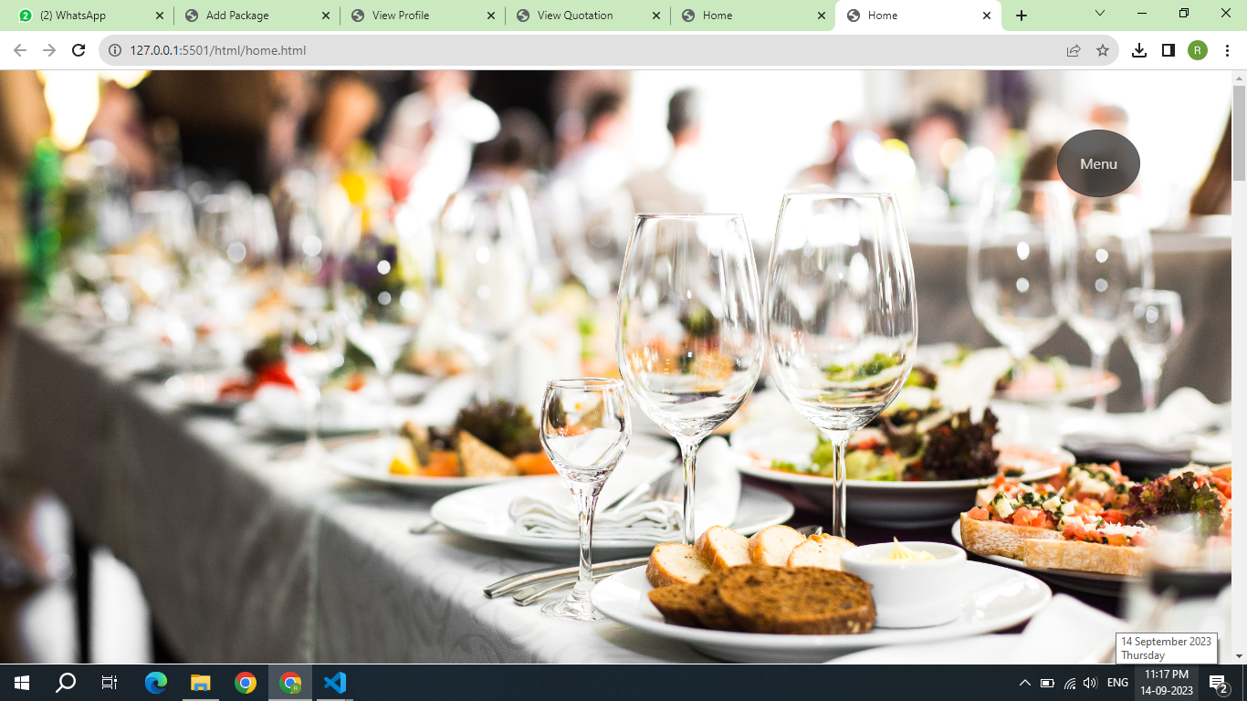
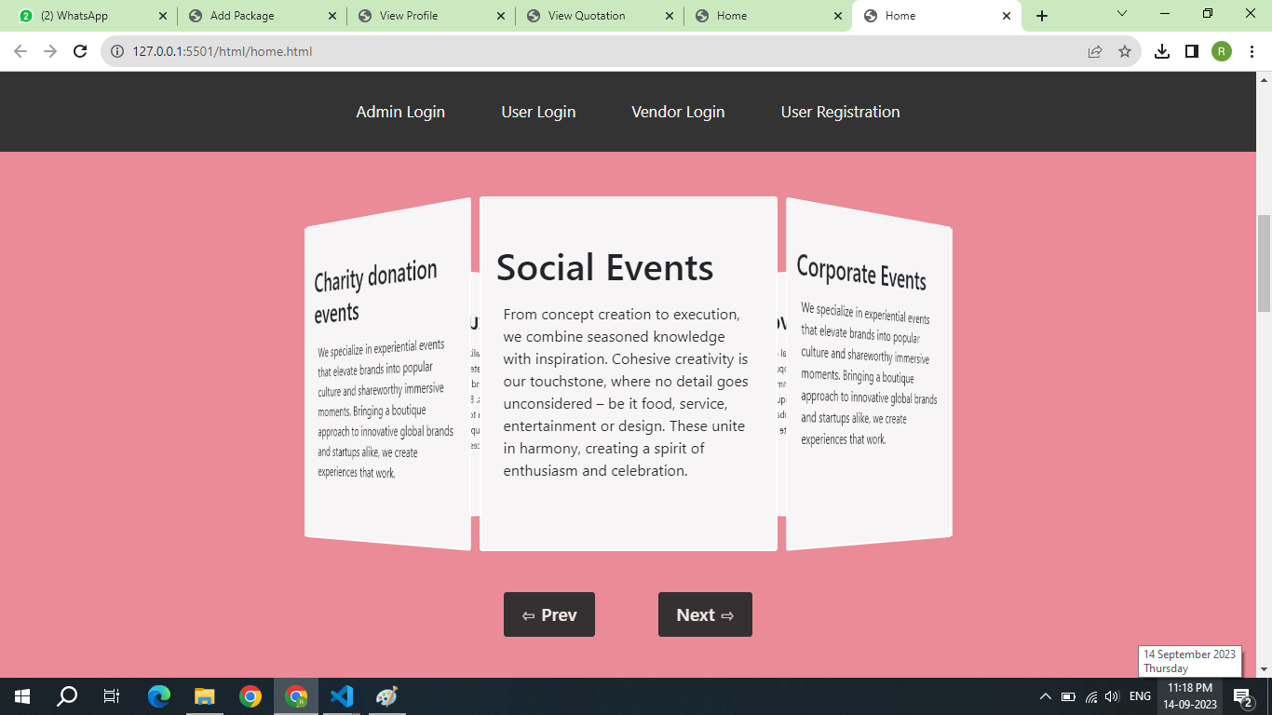
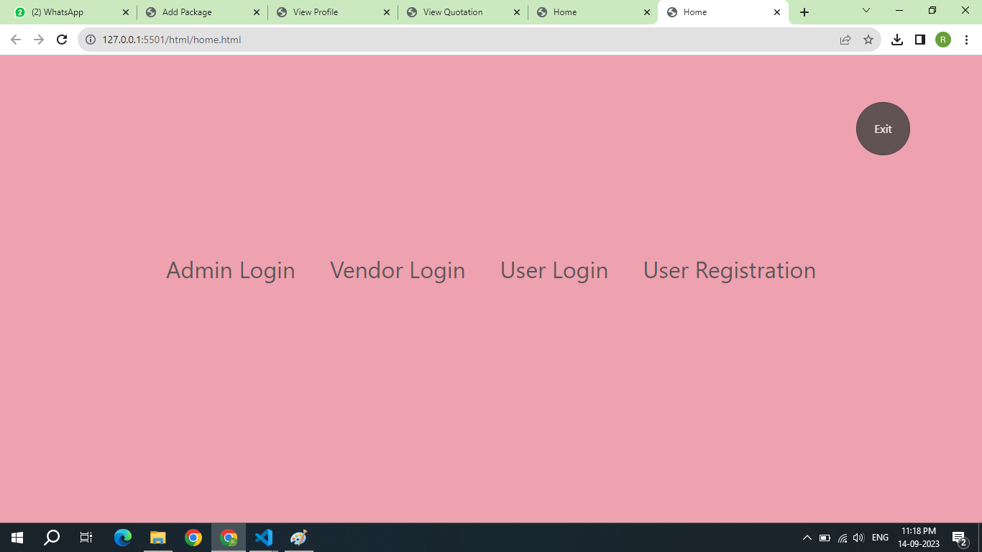
HOME PAGE

Slide 11
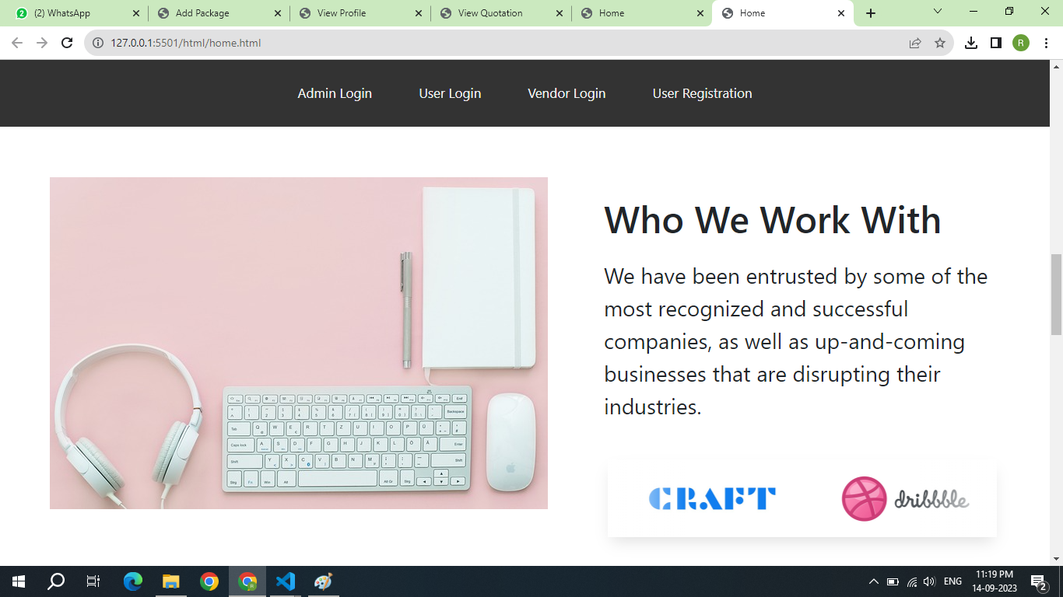
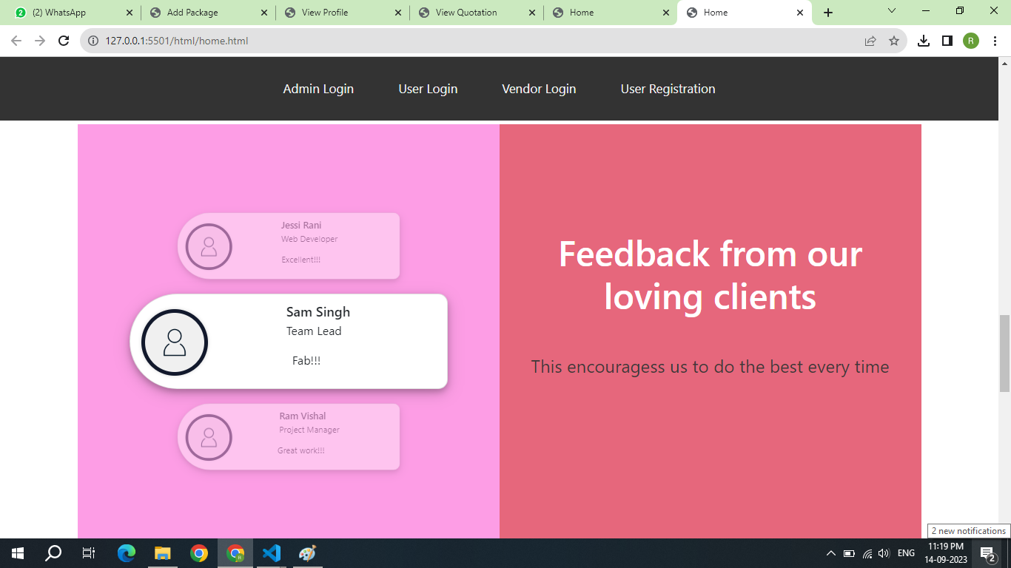
HOME PAGE

Slide 12
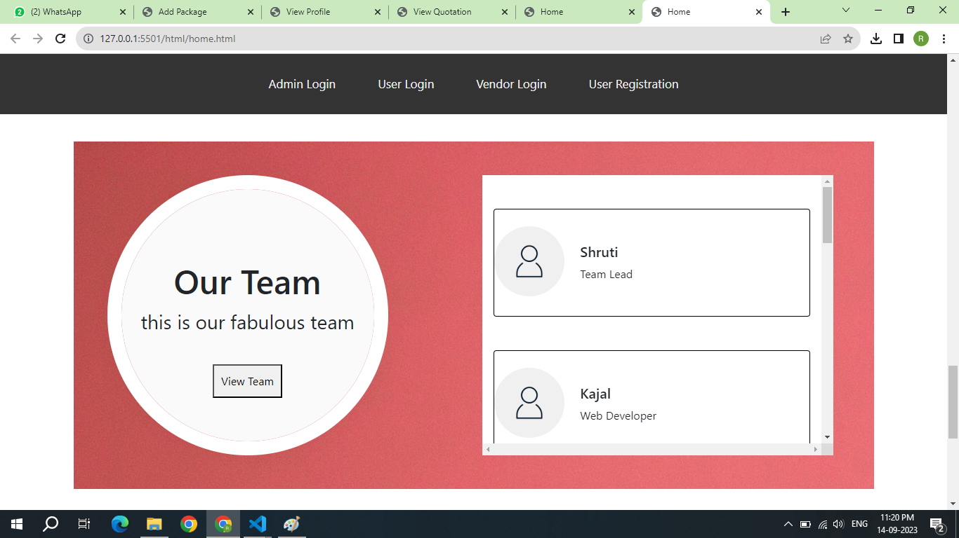
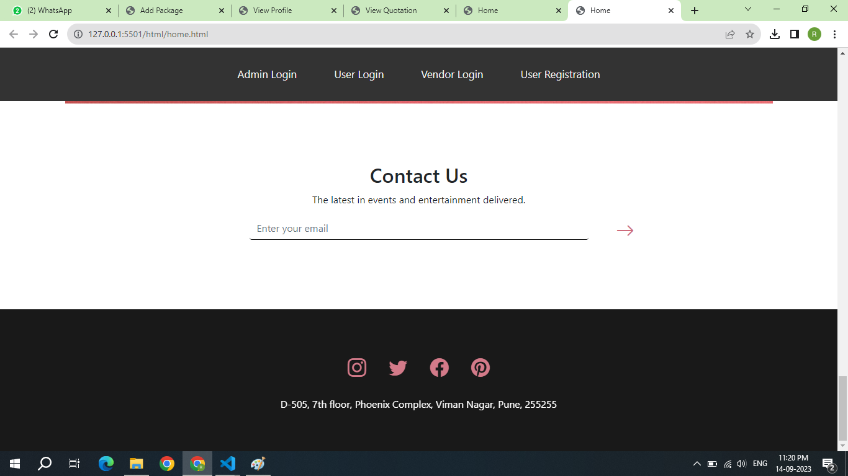
HOME PAGE

Slide 13
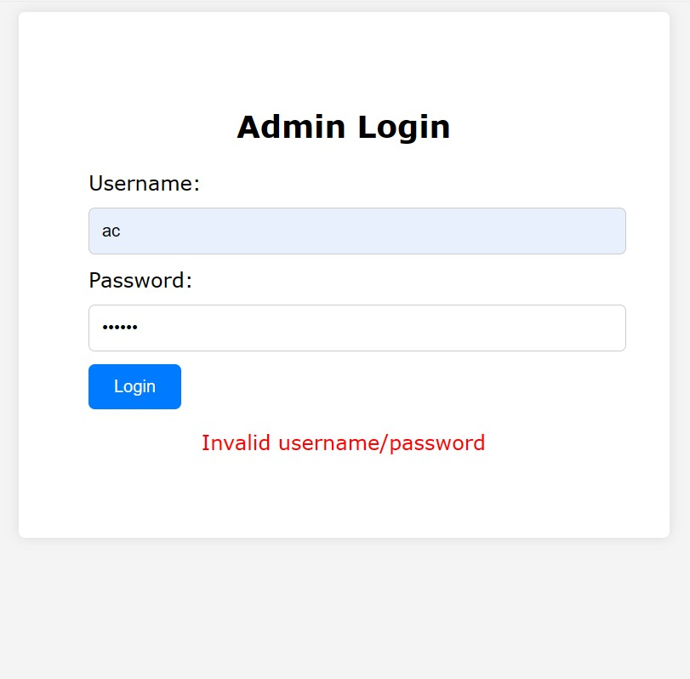
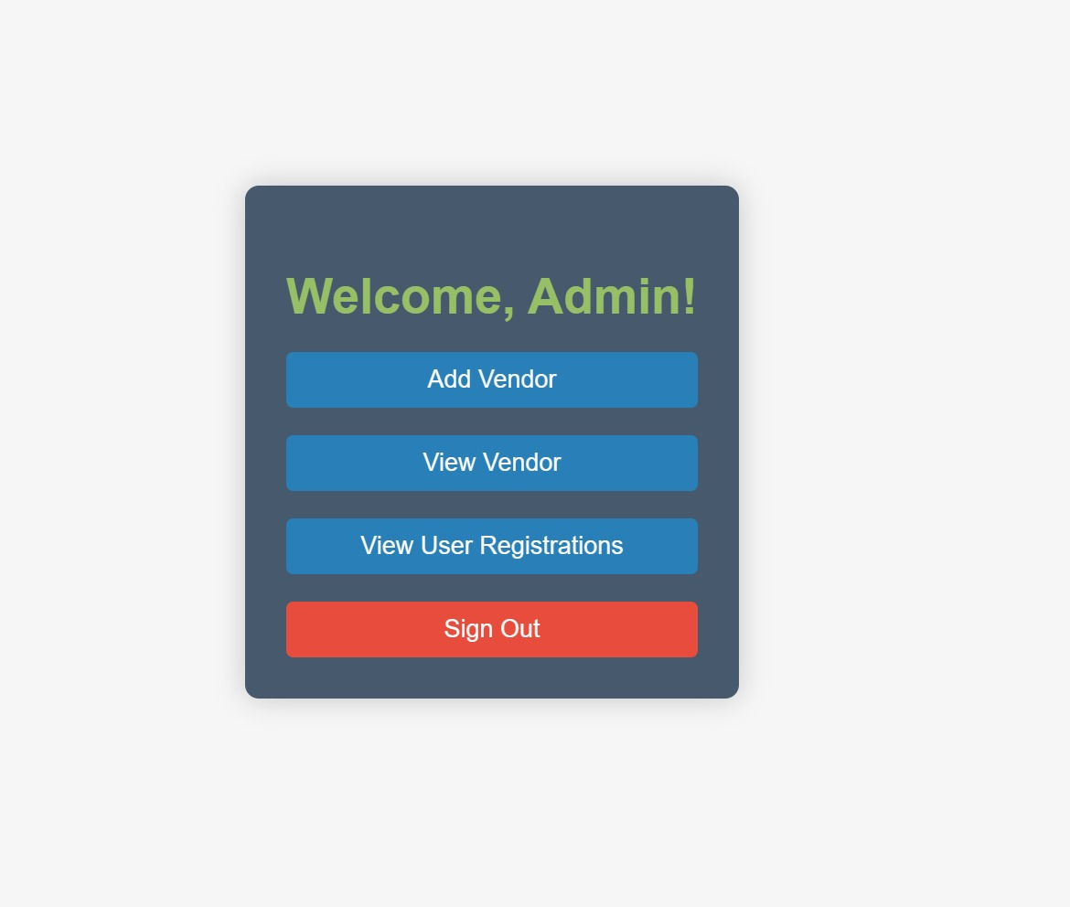
ADMIN

Slide 14
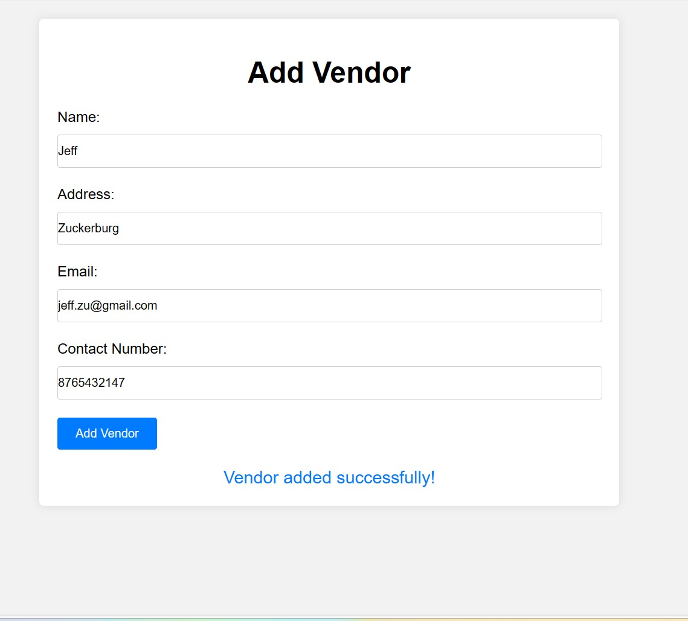
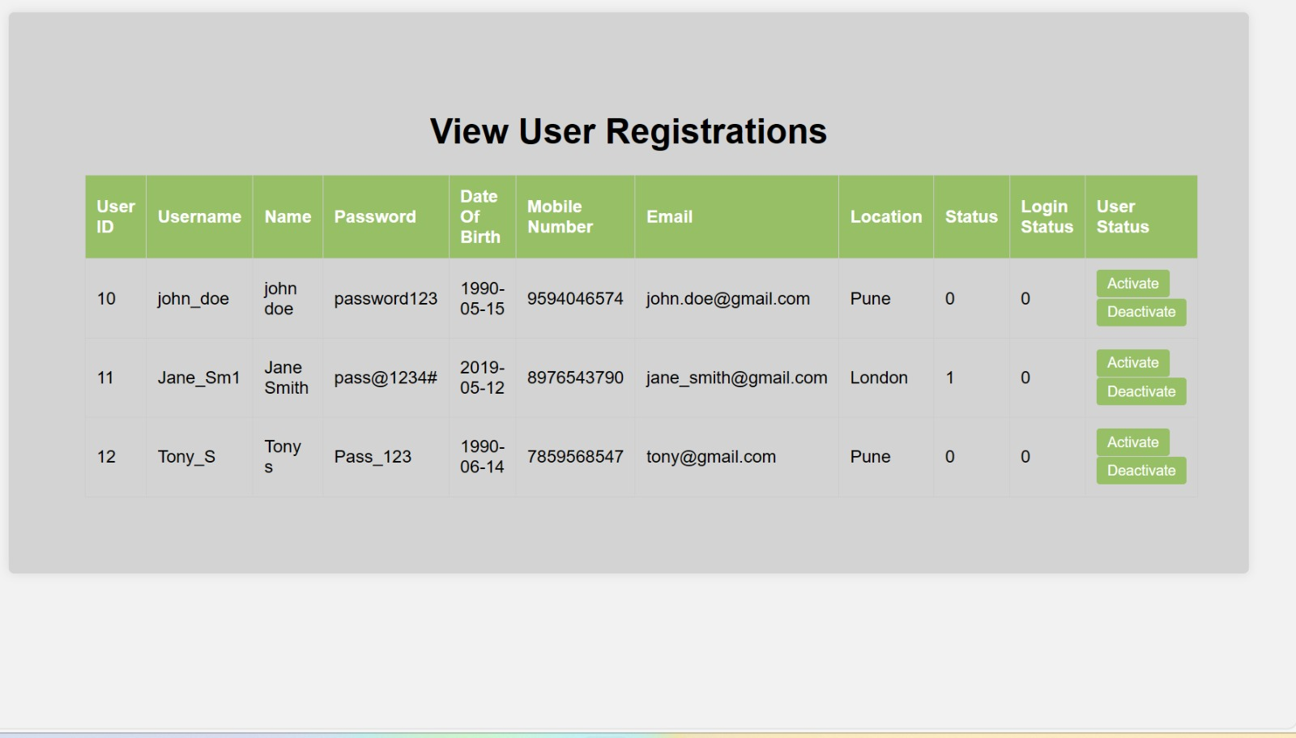
ADMIN

Slide 15
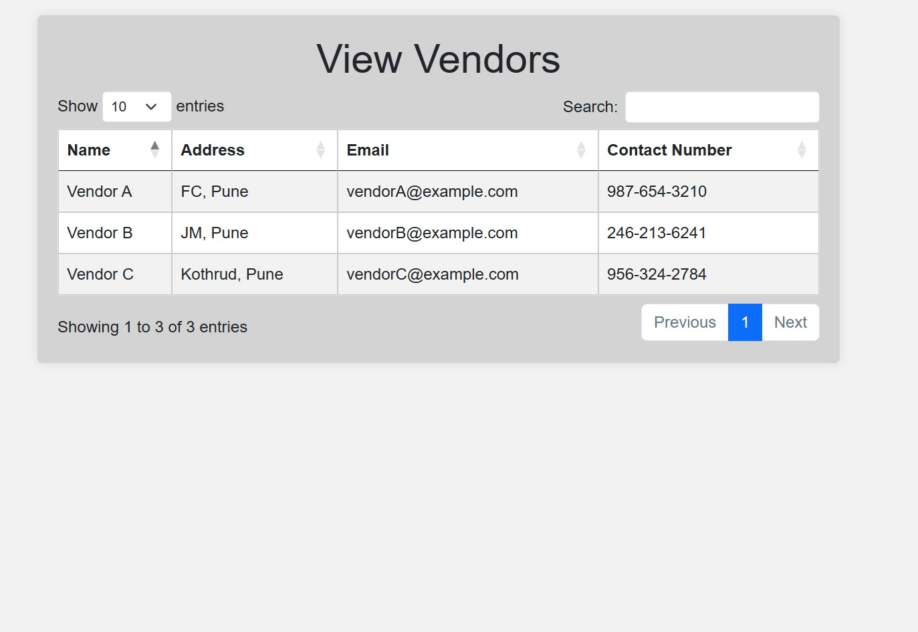
ADMIN

Slide 16
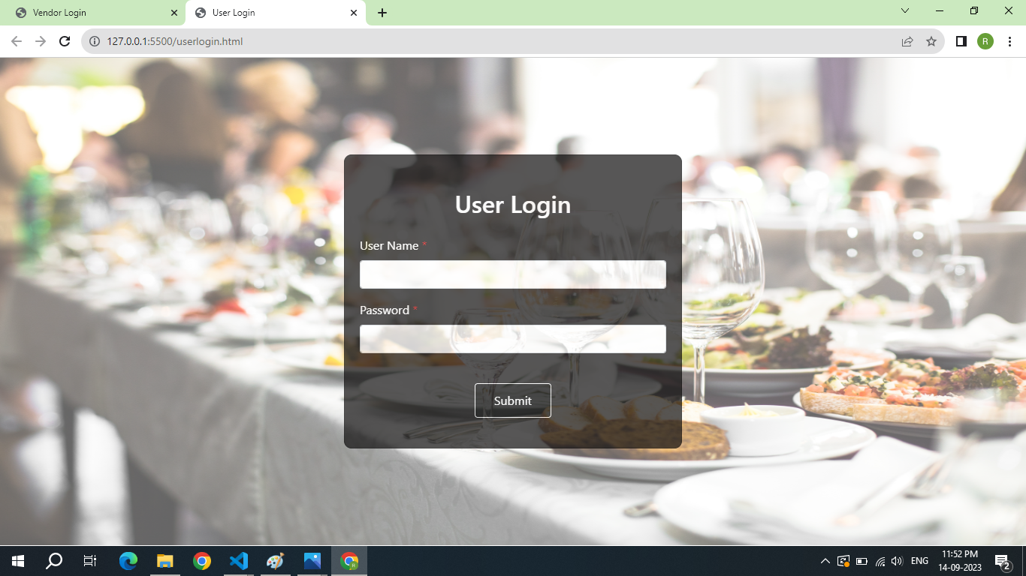
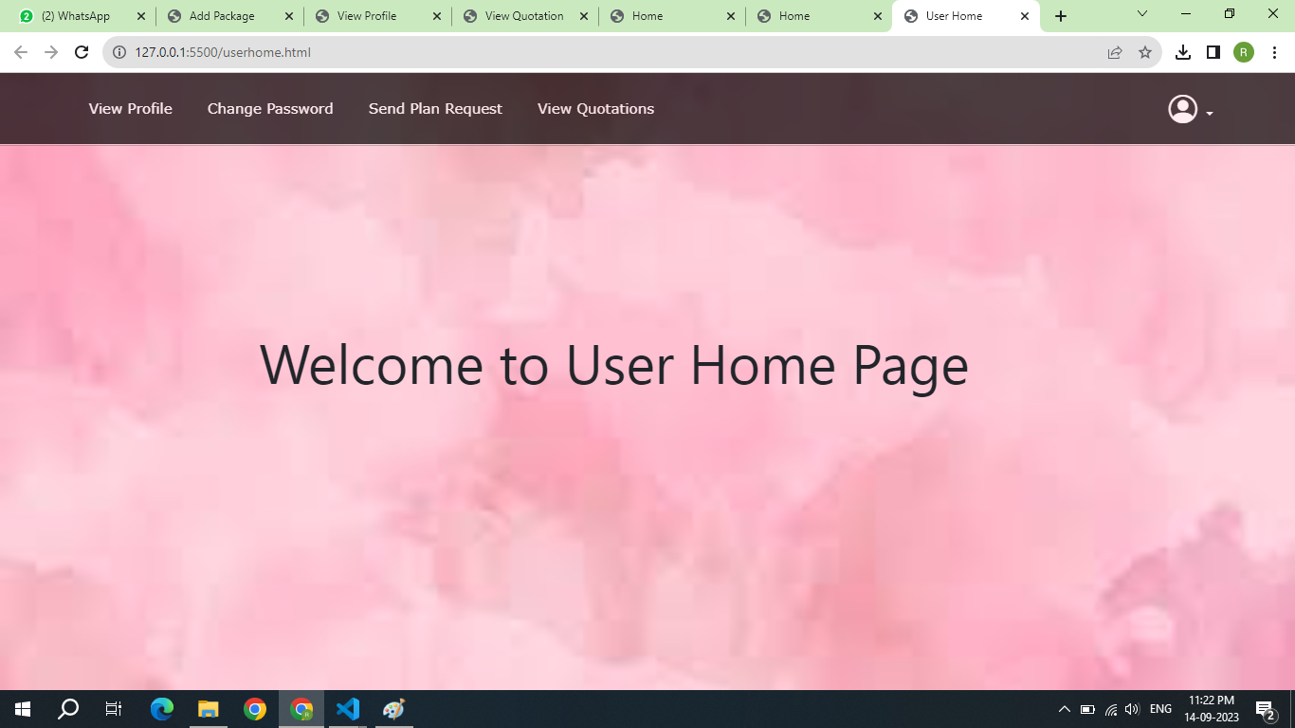
USER PAGES

Slide 17
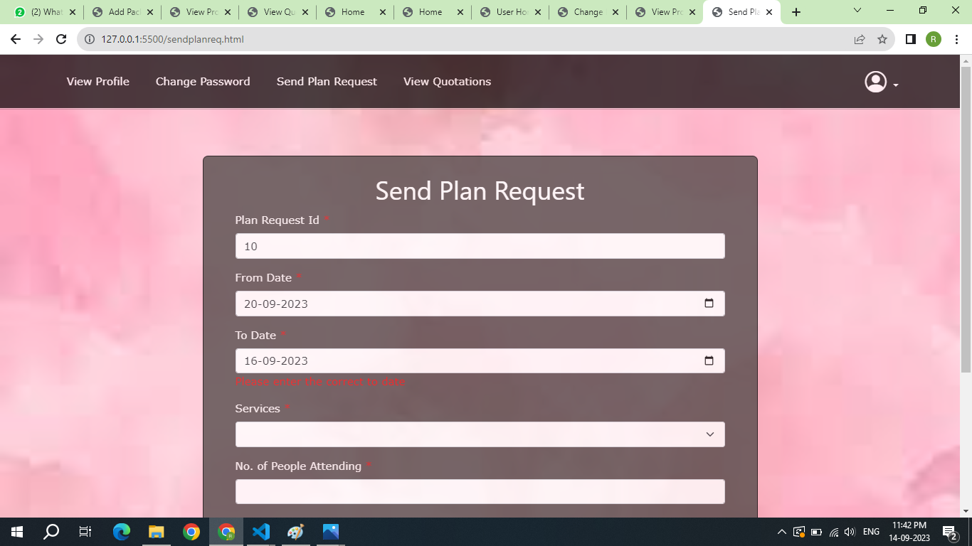
USER PAGES

Slide 18
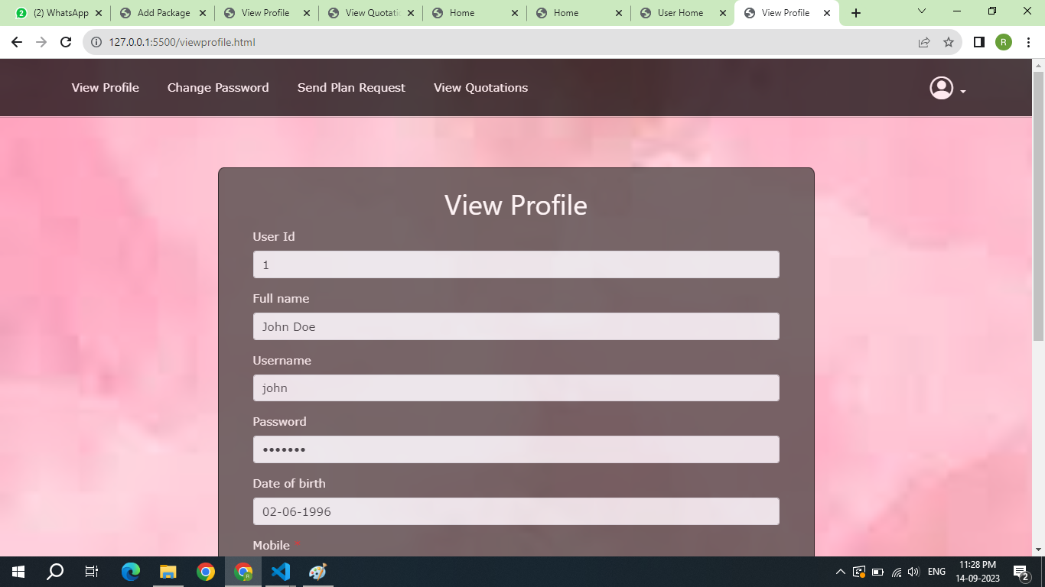
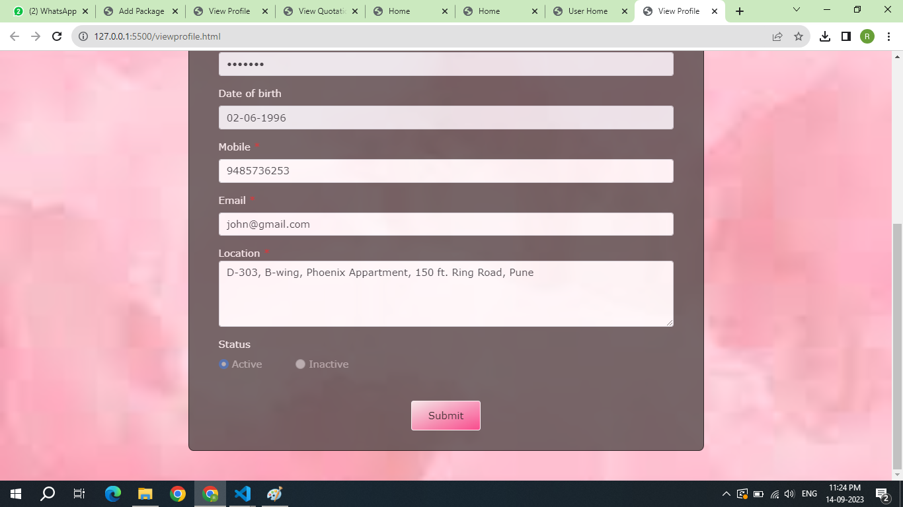
USER PAGES

Slide 19
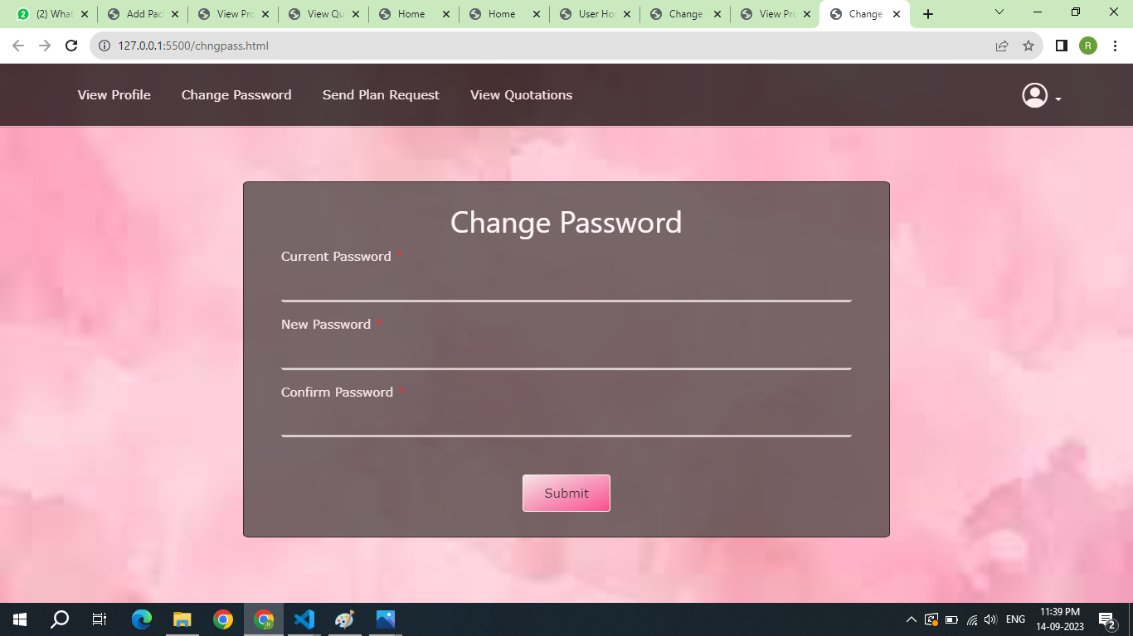
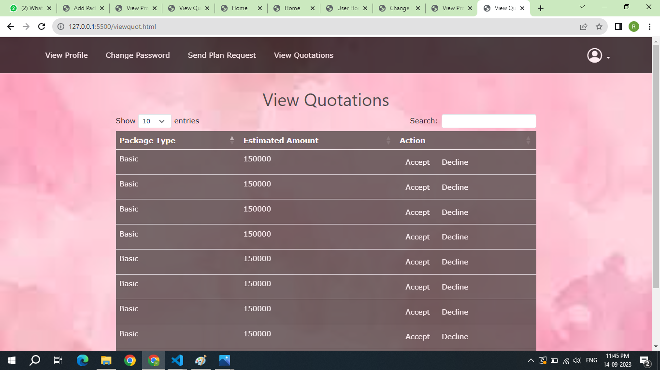
USER PAGES

Slide 20
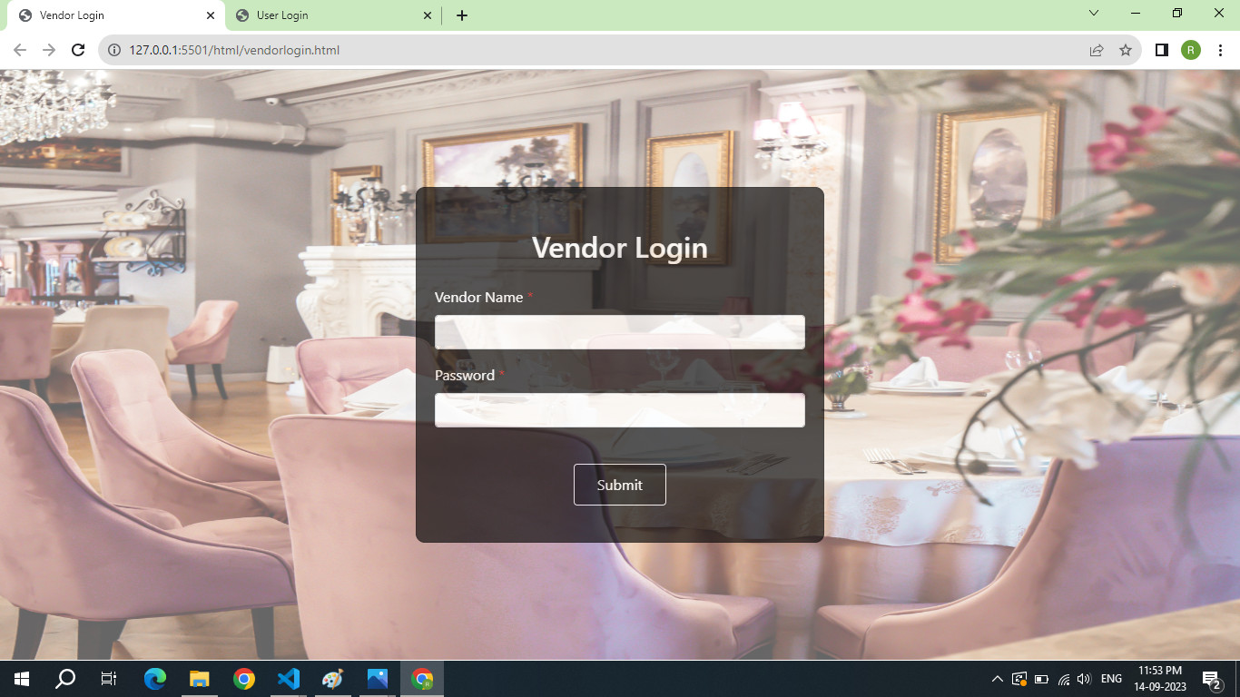
VENDOR PAGES

Slide 21
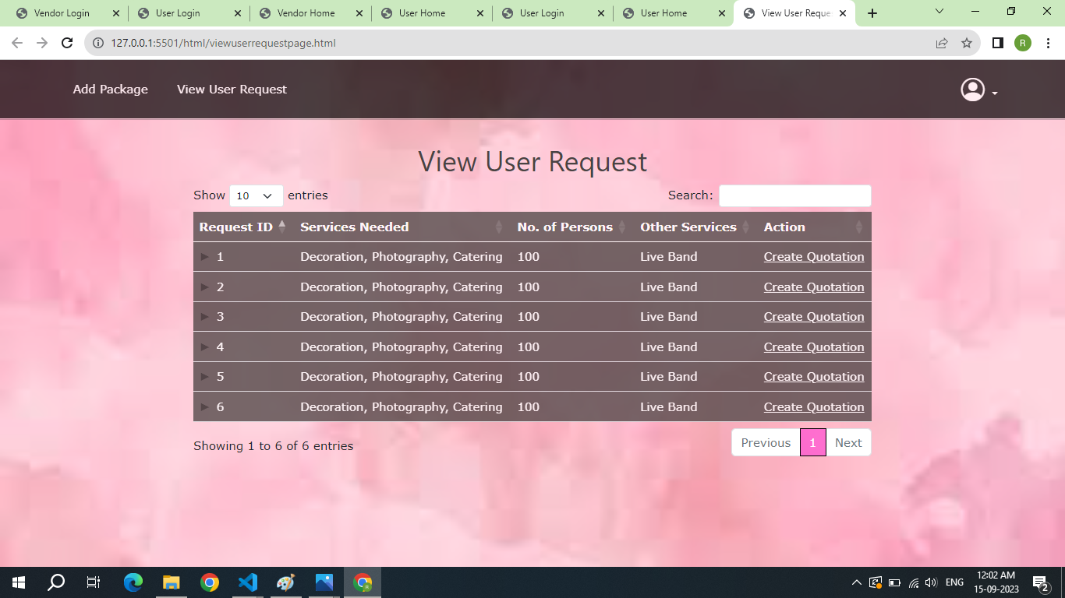
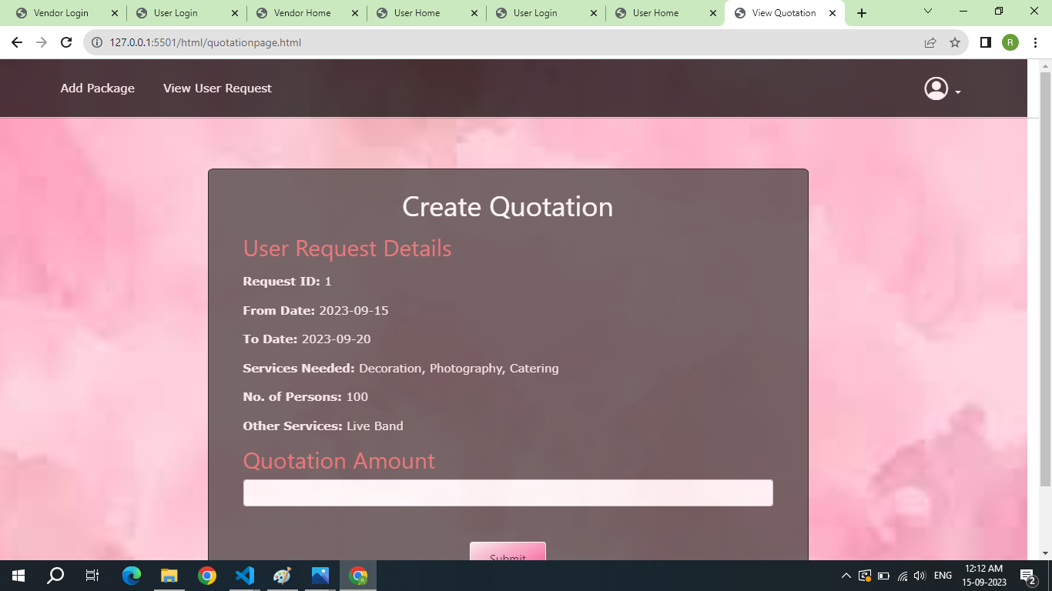
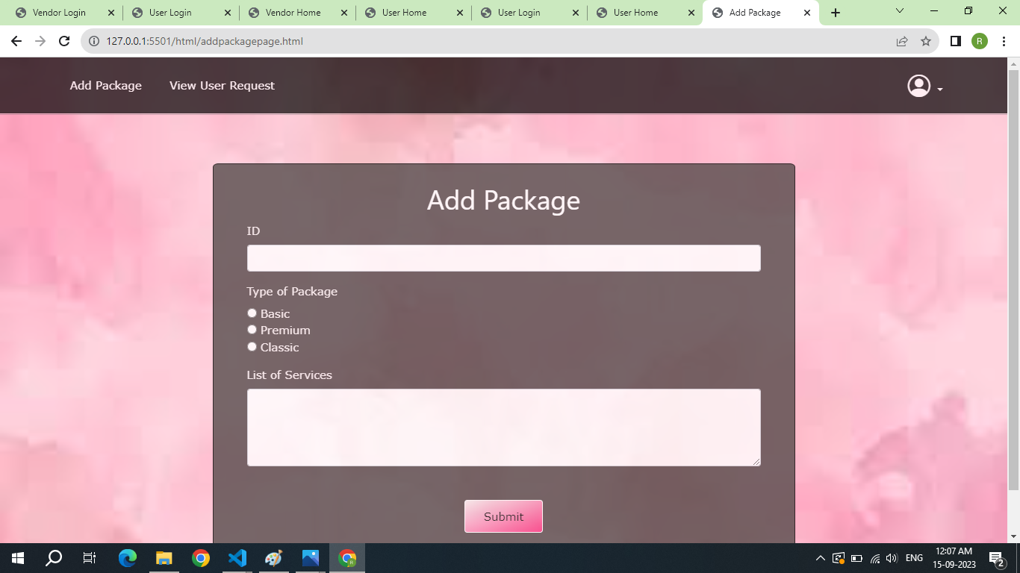
VENDOR PAGES

Slide 22


PROJECT BENEFITS
The Event Management System is a game-changer for event planners and organizers.
Hassle free and easy to use
Cost-effective and efficient
Quickly create and manage events with just a few clicks.
No more hassle with spreadsheets or paper forms.
Reduce the time spent on administrative tasks.
Increase in attendee engagement and satisfaction.
Less printing costs

Slide 23

CONCLUSION
In conclusion, the Event Management System is a powerful tool that can revolutionize the way events are managed. With its intuitive user interface and advanced features, it can help event organizers save time, reduce costs, and improve attendee satisfaction.
Whether you're planning a small corporate meeting or a large-scale music festival, the Event Management System has everything you need to make your event a success. So why wait? Try it out today and experience the benefits for yourself!

